Slide 1
MUSIC MATCHES MOOD
TEAM MEMBERS:
Pavan Kalyan(089)
Balaji(079)
Sai Kiran(099)

Slide 2
ABSTRACT
This project in python language of Music matches mood player is a simple console based GUI application using pygame module
The python project named Music matches mood is a music player that recommends user songs based on their mood. There are songs for moods like happy, sad and party. User can enjoy the songs and can add the songs he/she likes to the favorites list. It isn't mandatory for the user to create an account. He/she can just use guest login feature but cannot add songs to favorites list.
This program is made by using tkinker module

Slide 3
TECHNOLOGY USED
Pygame
Pyqt5
Qt designer
Tkinker

Slide 4
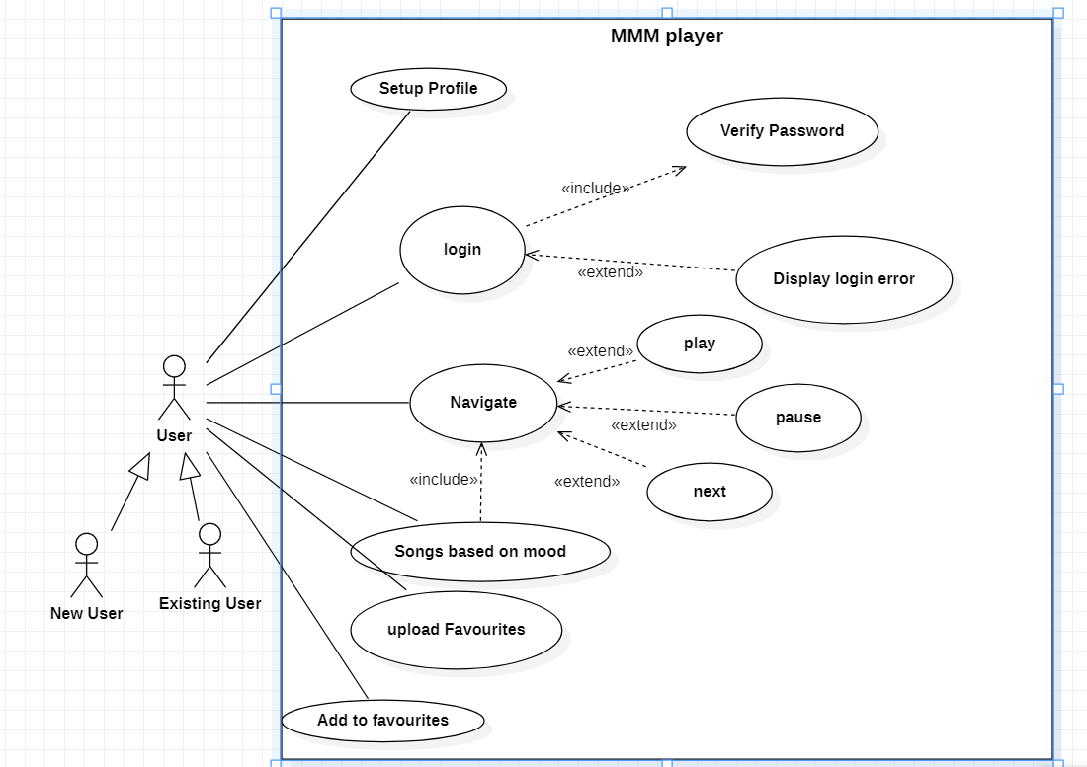
USE CASE DIAGRAM

Slide 5
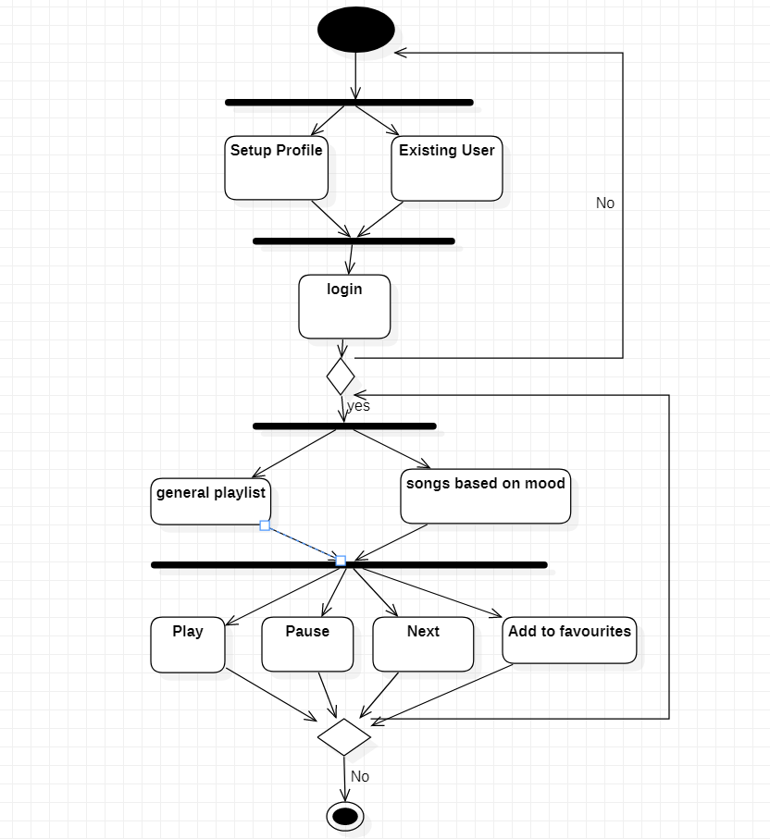
ACTIVITY DIAGRAM:

Slide 6
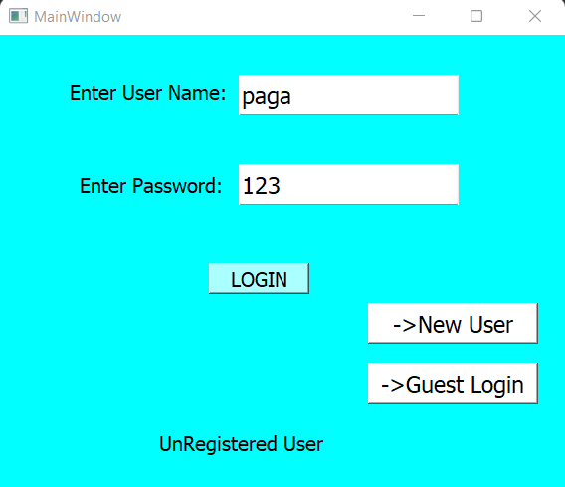
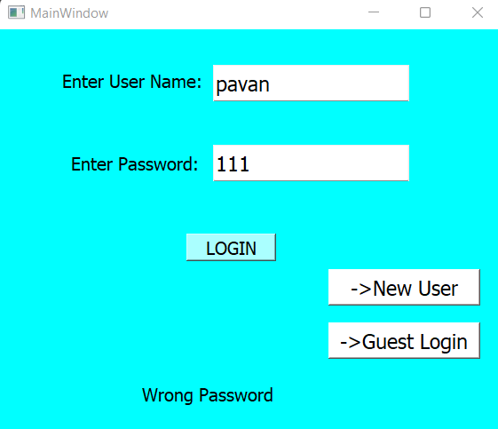
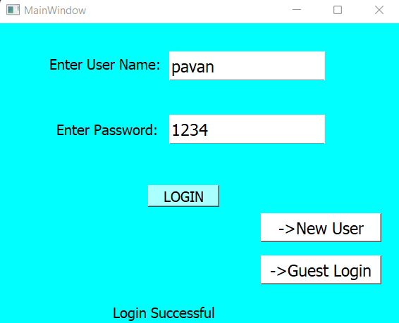
OUTPUT

Slide 7
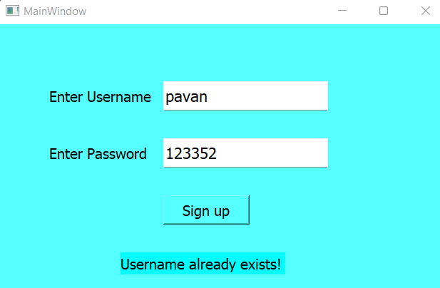
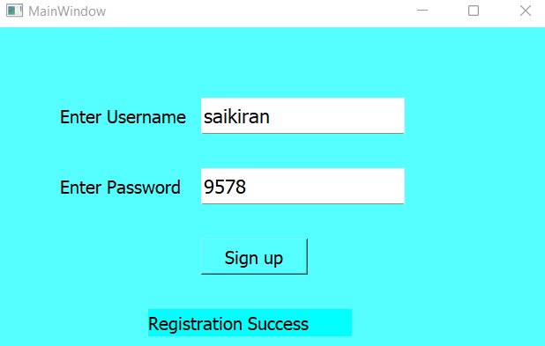
OUTPUT

Slide 8
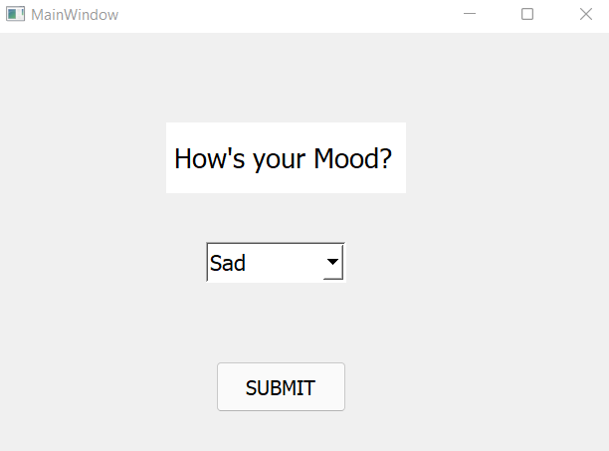
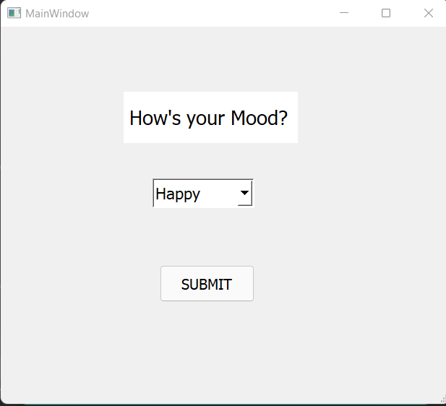
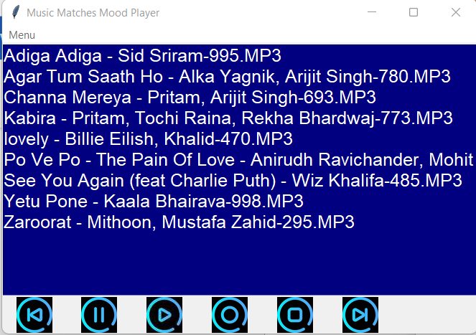
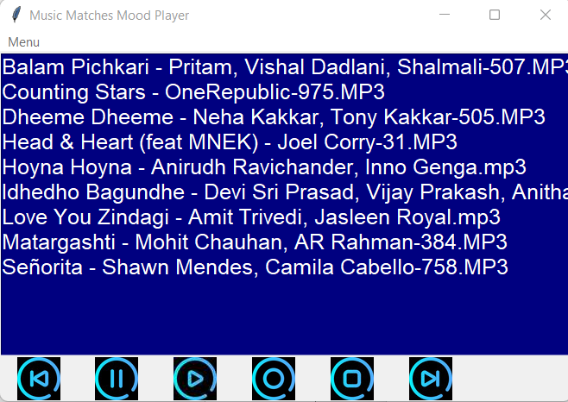
OUTPUT

Slide 9
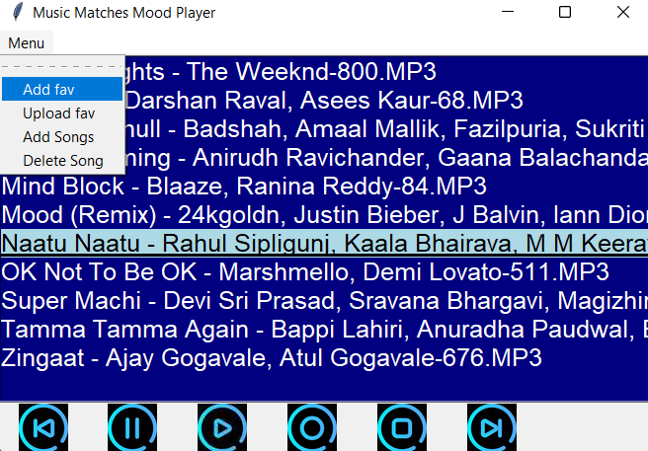
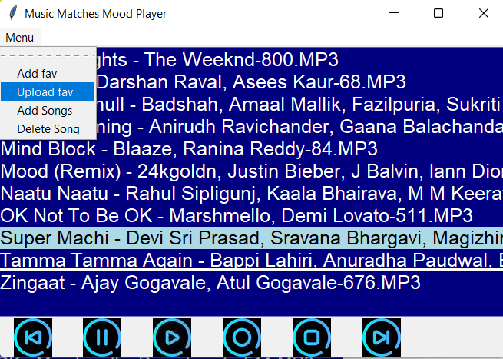
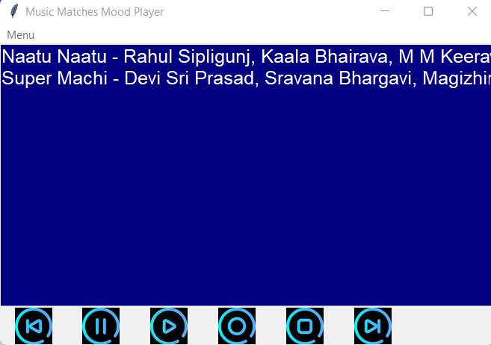
OUTPUT

Slide 10
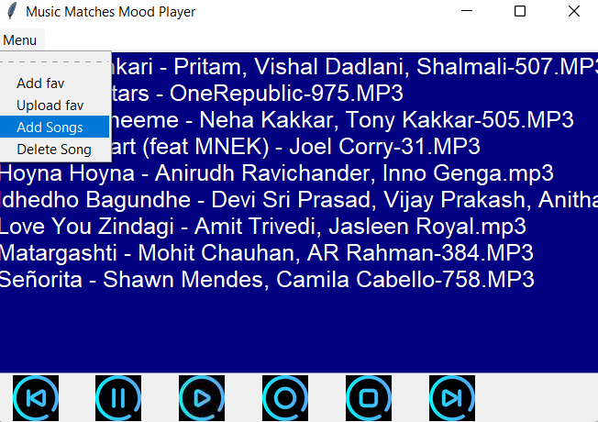
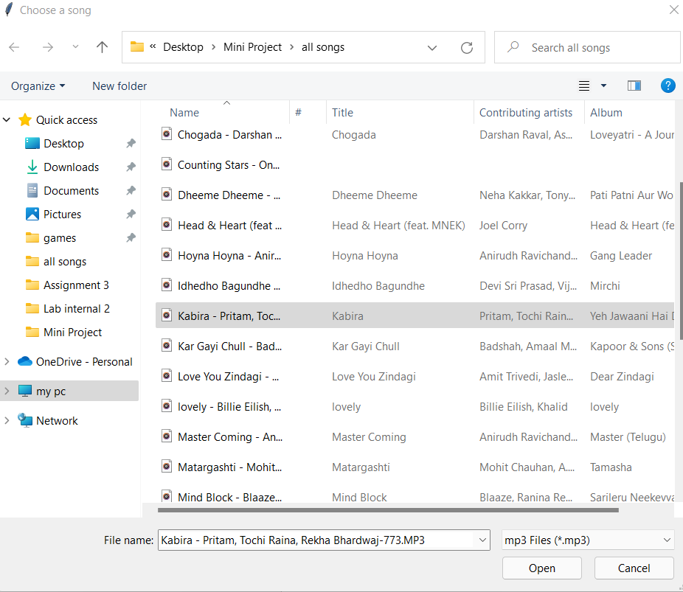
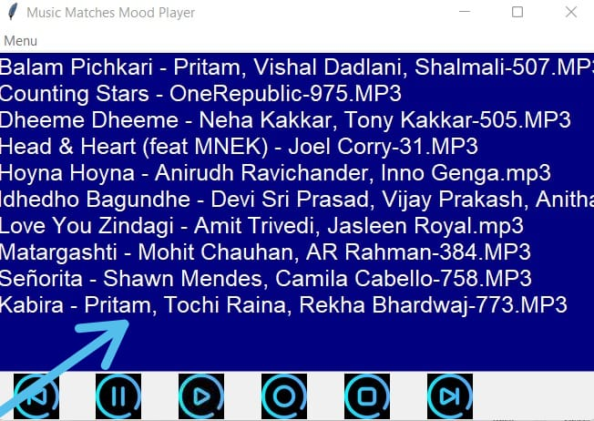
OUTPUT

Slide 11
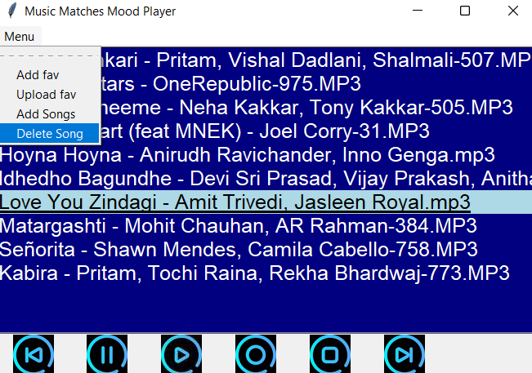
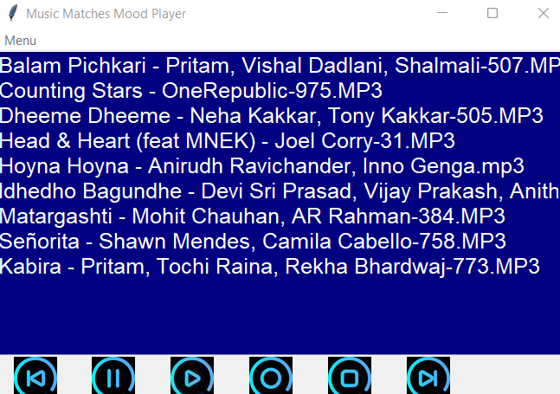
OUTPUT

Slide 12
SQL
ML
Storing data using SQL
Using machine learning to recommend songs.
Future Work
Lyrics
Adding lyrics to songs(speech to text).
EQUALIZER
Adding equalizer to amplify music based on our interests.

Slide 13
THANKS!

